Slide 1
Linked Lists

Slide 2
Linked List is a sequence of links which contains items. Each link contains a connection to another link.
4
6
3
2

Slide 3
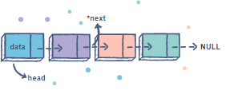
Singly Linked List
A singly linked list is a type of linked list that is unidirectional, that is, it can be traversed in only one direction from head to the last node (tail).
Each element in a linked list is called a node. A single node contains data and a pointer to the next node which helps in maintaining the structure of the list.
Notes:
The first node is called the head; it points to the first node of the list and helps us access every other element in the list. The last node, also sometimes called the tail, points to NULL which helps us in determining when the list ends.

Slide 4
Inserting a node
1) At the front of the linked list
2) After a given node.
3) At the end of the linked list.

Slide 5
Delete a node
To delete a node from the linked list, we need to do the following steps.
1) Find the previous node of the node to be deleted.
2) Change the next of the previous node.
3) Free memory for the node to be deleted.

Slide 6
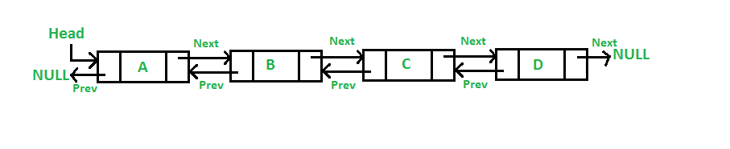
Doubly Linked List
A Doubly Linked List (DLL) contains an extra pointer, typically called previous pointer, together with next pointer and data which are there in singly linked list

Slide 7
The “Runner technique”
The runner technique means that you iterate through the linked list with two pointers simultaneously, with one ahead of the other. The "fast" node might be ahead by a fixed amount, or it might be hopping multiple nodes for each one node that the "slow" node iterates through.

Slide 8
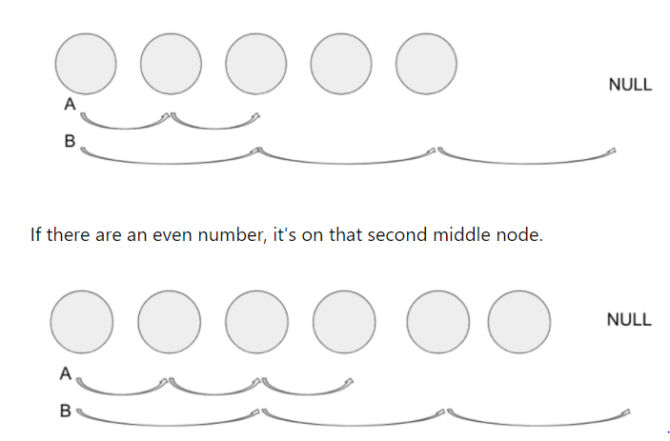

Slide 9
Example
Suppose you had a linked list a1->a2....->an->b1->b2....bn, and you want to rearrange it into a1->a2->...an->b1->b2....->bn.

Slide 10
Let n = 2. We are starting with a list:
a1 -> a2 -> b1 -> b2
Let p1 be a "fast" pointer initially pointing to the successor of head.
Let p2 be a "slow" pointer initially pointing to the head.
p1
a1 -> a2 -> b1 -> b2
p2
We move p1 by two and p2 by one until p1 reaches the end of the list (there is no next).
p1
a1 -> a2 -> b1 -> b2
p2
Move p1 back to the head.
p1
a1 -> a2 -> b1 -> b2
p2
Advance p2.
p1
a1 -> a2 -> b1 -> b2
p2

Slide 11
Weaving" starts.
Take element pointed by p2 and move it after p1. Advance p1 after inserted element.
p1
a1 -> b1 -> a2 -> b2
p2
Take element pointed by p2 and move it after p1. Advance p1 after inserted element.
p1
a1 -> b1 -> a2 -> b2
p2
p1 is null, terminate.

